Slide 1


Using Conda for Python Data Science projects

Slide 2

Outline of Presentation
What is (Ana)conda?
What is a ‘package manager’?
How can we install all of the packages that we need?
What is a conda environment?
Why do we need to use environments?
How does conda differ from other package managers?
Live demonstration of installation procedure – with command line tutorial

Slide 3
Anaconda distribution
https://www.anaconda.com/
Full data science platform for both individuals and enterprise teams
Not just focused on Python
Also uses R
But Python is the topic of this presentation
How I think of it:
A framework to install all the software I need for projects
How to keep this isolated from other software dependencies

Slide 4
Full version vs miniconda
Two main versions:
Anaconda
Miniconda
Anaconda includes a full GUI called the ‘Navigator’
Use a point and click interface to create environments and install packages
Easy to learn – but a large install
Miniconda
Everything done via the command line
Much smaller installation
Most online material will always use command line solutions

Slide 5

Blog article by Jake VanderPlas – Pythonic Perambulations
Conda: Myths and Misconceptions
https://jakevdp.github.io/blog/2016/08/25/conda-myths-and-misconceptions/
Ana/Mini-conda is a Distribution
“A software distribution is a pre-built and pre-configured collection of packages that can be installed and used on a system”
Conda is a Package-Manager
“A package manager is a tool that automates the process of installing, updating, and removing packages”
If JVP wrote something – read it!

Slide 6

My preference - Miniconda
Less bloat with the install
Most (all?) reference articles and blog posts will make references to terminal commands
As data scientists – you will work with code and scripts – the command line (once learned) is a fantastic tool
But Anaconda comes with many additional packages
Check it out for comparison

Slide 7

Installing miniconda
Go to https://docs.conda.io/en/latest/miniconda.html
Installers for Windows, Mac OSX, and Linux
Windows:
Use the graphical installer
Mac OSX:
I use the command line (bash) installer
Linux:
Only the command line option
You use Linux – you’ll figure it out!

Slide 8
Basic terminal commands
cd Change directory
cd ../ Change to the ‘parent’ directory
~ References the ‘home’ directory
ls ~ List the ‘home’ directory
ls ~/Desktop List the Desktop directory (from any location)
ls List the current directory
mv Move a file to a different directory
mkdir Make a new directory
rmdir Remove an empty directory
rm Remove a file (it does NOT go to your recycle bin!!! 😧)
rm –f ‘Force’ remove a protected file 😰
rm –r ‘Recursively’ remove a directory with all sub directories be VERY careful 😱
rm –rf Force remove into all sub directories – be BEYOND careful 🤯

Slide 9
Mac OSX installation
First – install iTerm2
https://www.iterm2.com/
It ‘does amazing things’ 👀
Change into directory with the miniconda installer
Miniconda3-latest-MacOSX-x86_64.sh
Run the following, accept Terms and defaults
./Miniconda3-latest-MacOSX-x86_64.sh
‘./’ means ‘run this script from here’
Needed as the directory you are in is not in your PATH
Of note - You can view your path by typing
echo $PATH
The $ sign means ‘Environment Variable’

Slide 10
Best resource for all conda commands
Refer to the documentation at:
https://docs.conda.io/projects/conda/en/latest/user-guide/tasks/manage-environments.html

Slide 11
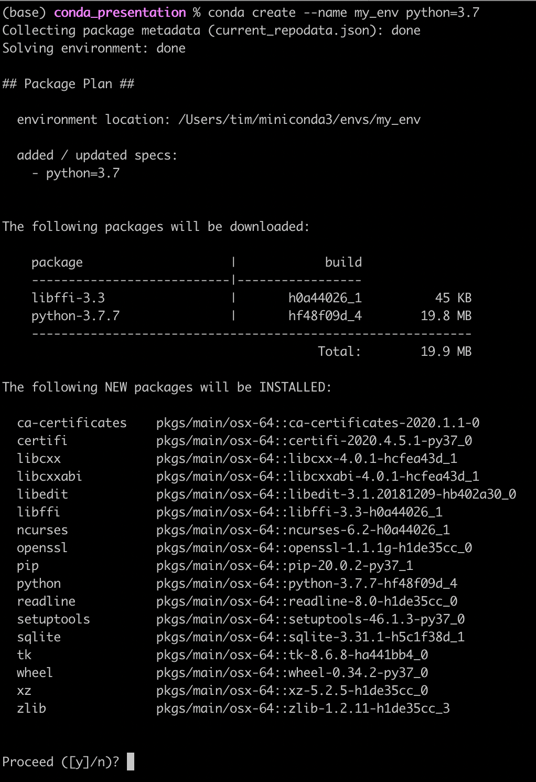
Creating an environment
A new environment is made by using the conda create command
In this, you can specify the version of Python – and the name of the environment you wish to create
A summary of what will be installed is given to you
To proceed – press y

Slide 12
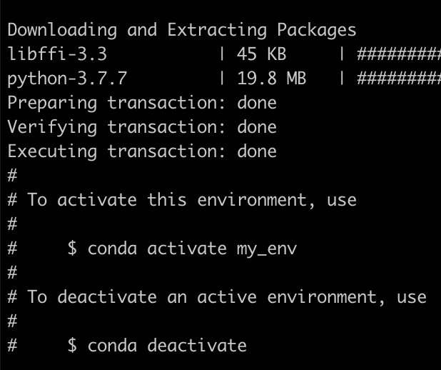
Note the output screen
This is Very Important for you to remember
You must move into this environment in order to install material into it
You will make this mistake periodically for the rest of your career!
Note the following:
activate
deactivate

Slide 13
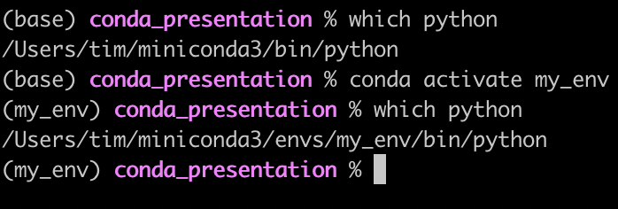
Location of Python Binary after activating environment
With my terminal setup – it shows that the environment is activated
Using the which command – we can now see where the Python binary is located

Slide 14
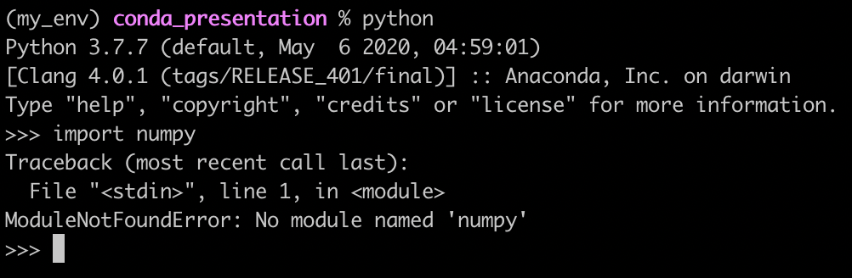
Just the minimum package
Think of this as a fresh Python installation
We don’t yet have what is needed for a data science project

Slide 15
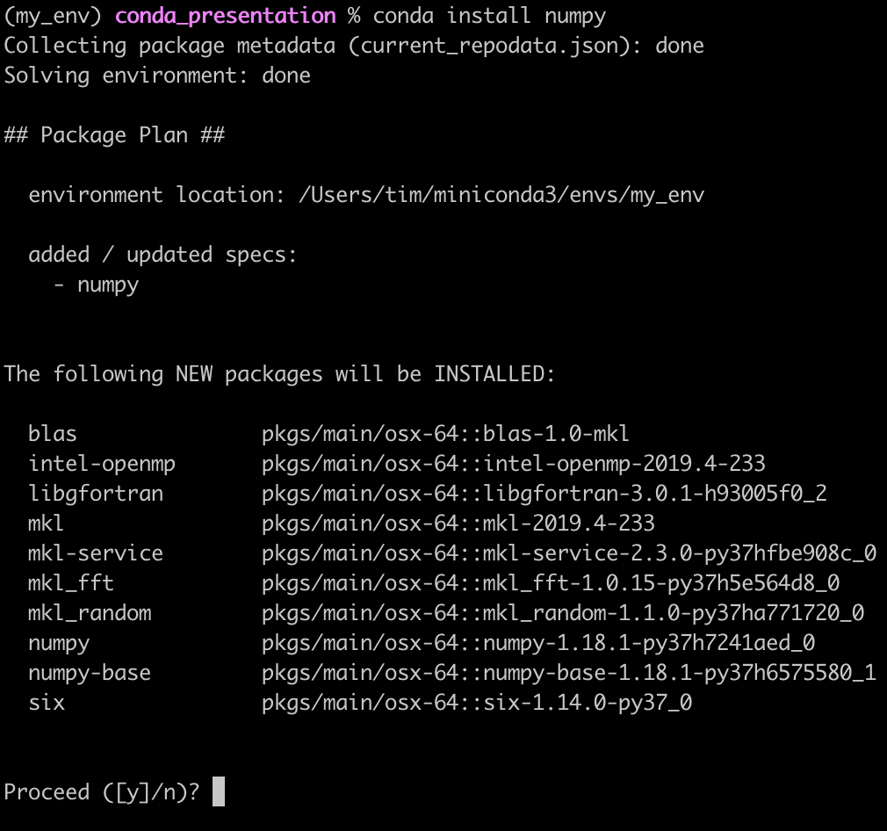
Installing numpy
This is done using the simple command: conda install numpy

Slide 16
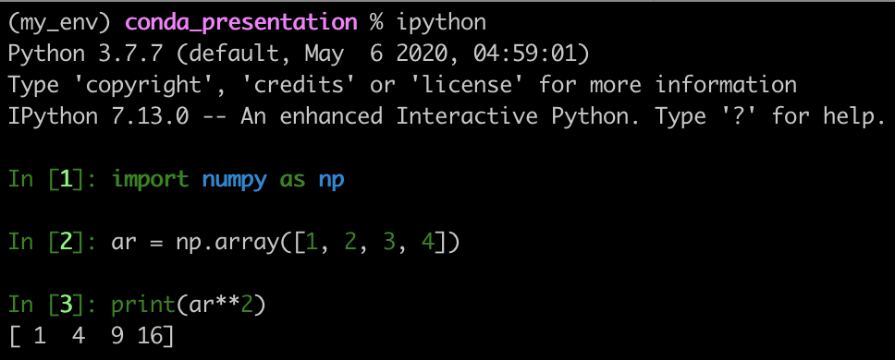
Be kind to yourself!
Just make a habit of doing:
conda install ipython
We can also see that numpy has been installed

Slide 17
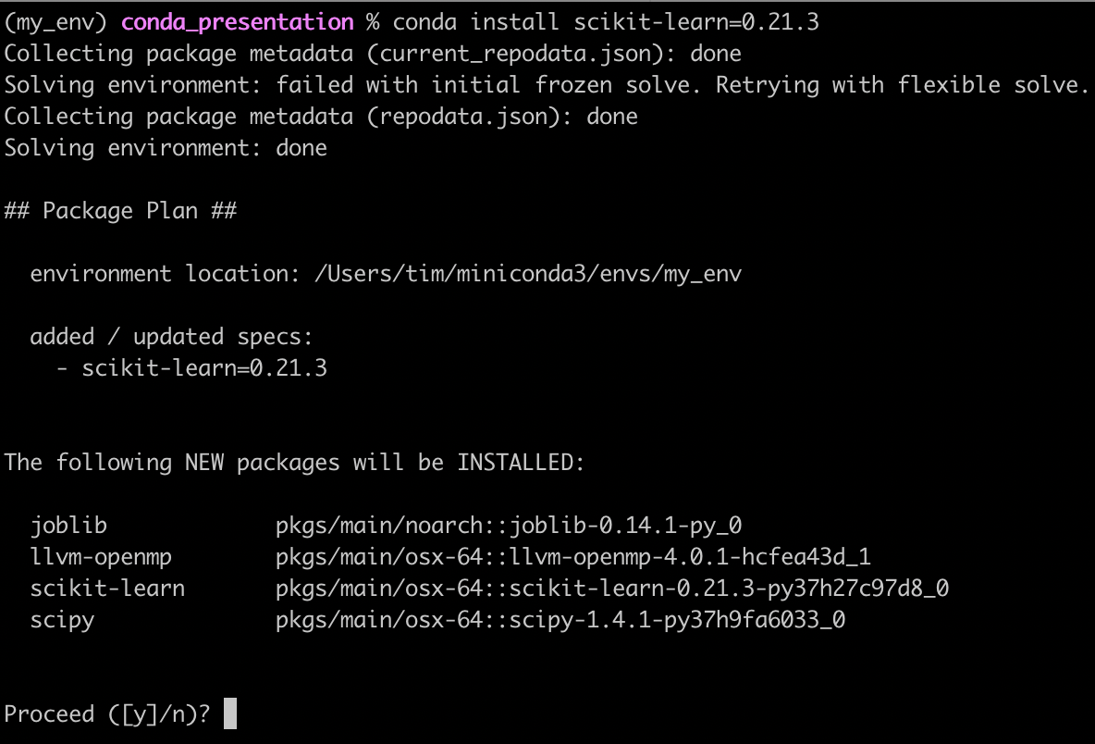
Installing a specific version
Due to dependency problems, you might have to use earlier versions of packages
This is where using an isolated environment really comes into its own
This is done with the following command:
conda install <package>=<version>
Here, we install a version of scikit-learn that is not the latest stable version
This was due to a genuine problem I was having using the latest version of scikit-learn with the ‘yellowbrick’ library
This shows that this is not just a ‘token’ example

Slide 18
Thanks for listening
If anyone has any issues – either contact us
We can help to do this in person in a social meetup as soon as the lockdown is relaxed

